Slide 1
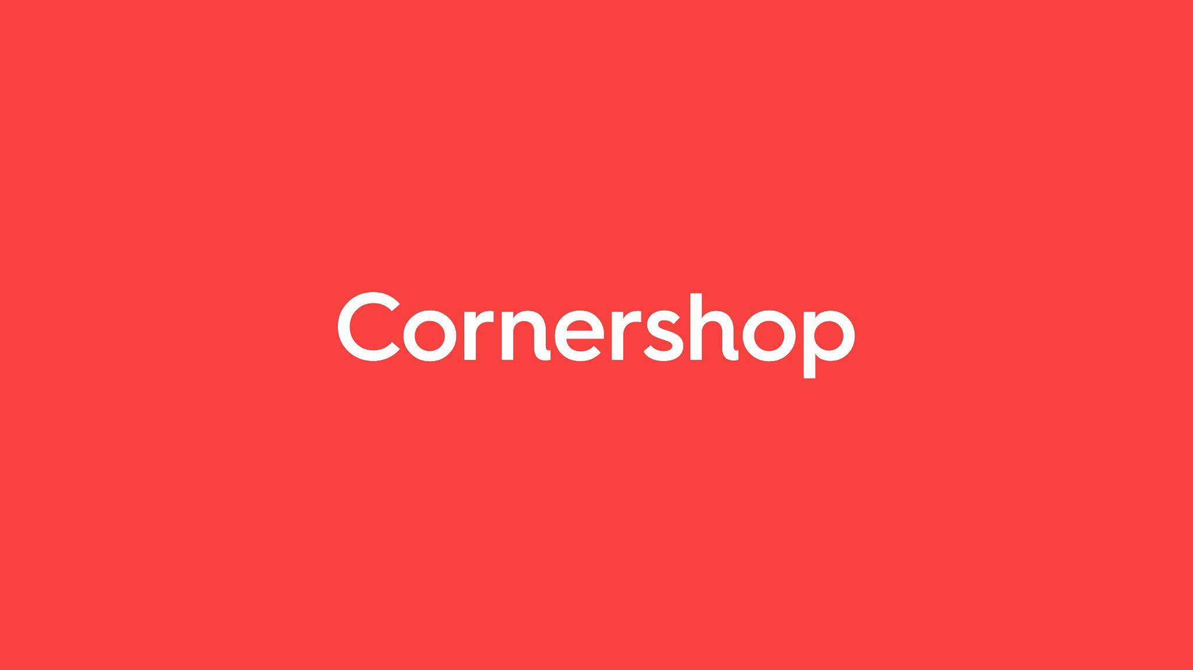

Business Case
Kelvin Okuda
31/12/2021
by Uber

Slide 2

Catalog - Business Case
Hello, congratulations! You have reached a new stage in this process.
On three slides, we want you to show us the following:
1. Have a look in our catalog. What would you make it better?
2. We are partners with a huge grocery chain in Brazil, and a few of its branches are presenting bad FR: Porto Alegre, Santos and Campinas.
a) We investigated the categories, product (if there is any specific offender), day and hour data and found no trend.What else would you analyze in order to improve these branches’ FR?
b) Which tests would you do in order to have more insights on the issue?
3. A big partner of us is having drops of almost 3 points in FR at every 1st week of the month. What is your hypothesis on that? What can we do in order to not have those drops that impact our customer experience?
Have fun!

Slide 3
Q&A - 1
Have a look in our catalog. What would you make it better?

Slide 4
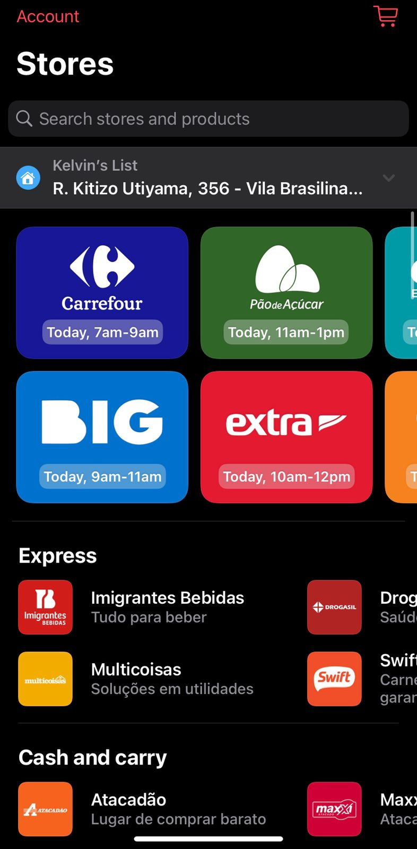
.Have a look in our catalog. What would you make it better? main page
1. Portuguese language should be an option if the idea is to become popular.
If I was to use any app for groceries shopping, I’d hope to see in which player (carrefour, pão de açúcar, extra) I would save more money (considering deals and all the fees included) or which has more available items from a list of products that I want to buy. This kind of feature would help me to shop better and do not waste time going into every one of the grocery stores, putting the items in the cart, and then seeing how much it would cost.
2. Banner at the top, displaying deals (it could be promoted or not) instead of big store cards.
3. There should have a card for deals and promos.
4. The categories could be represented by icons and once you hit the button, it opens another screen with the stores that are grouped by the category.
5. There are too much screen to be scrolled down. It has to be cleaner and shorter.

Slide 5
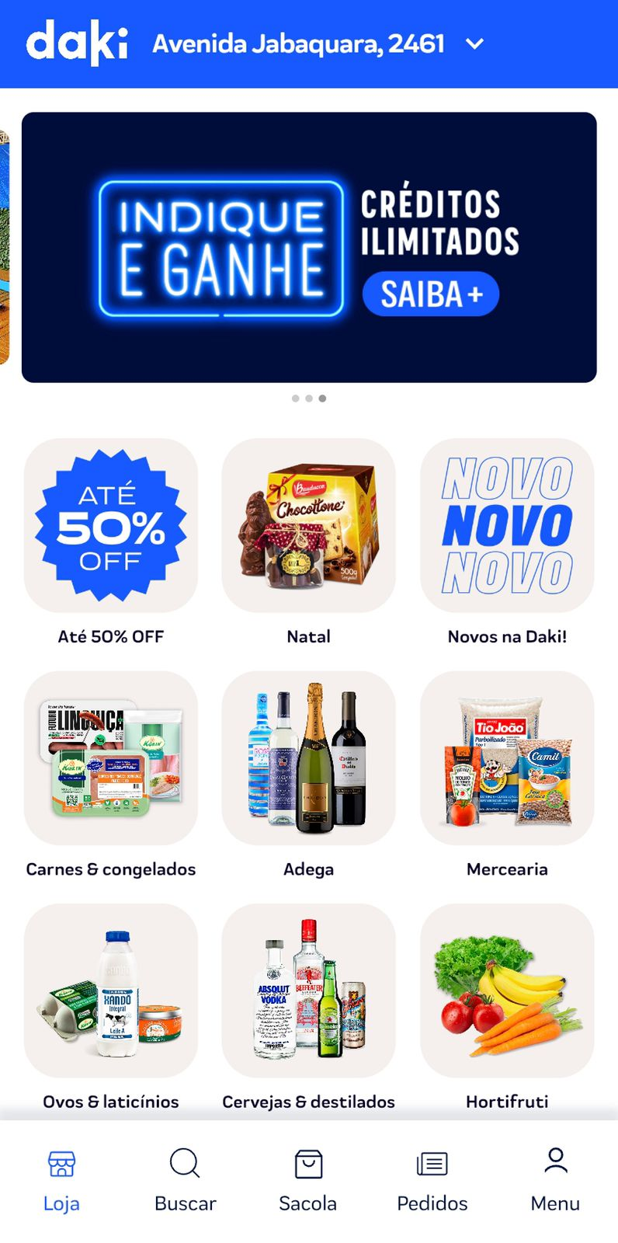
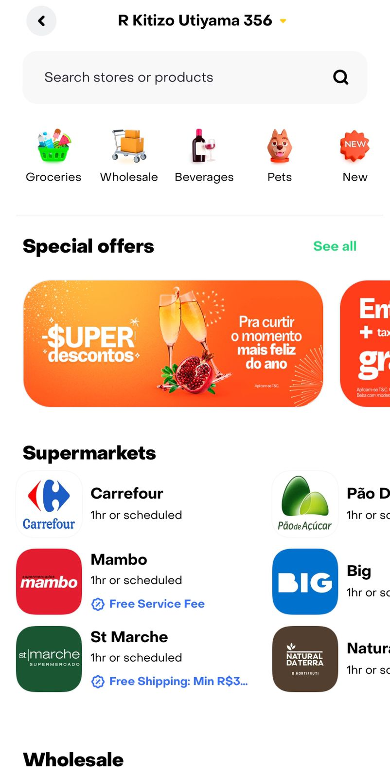
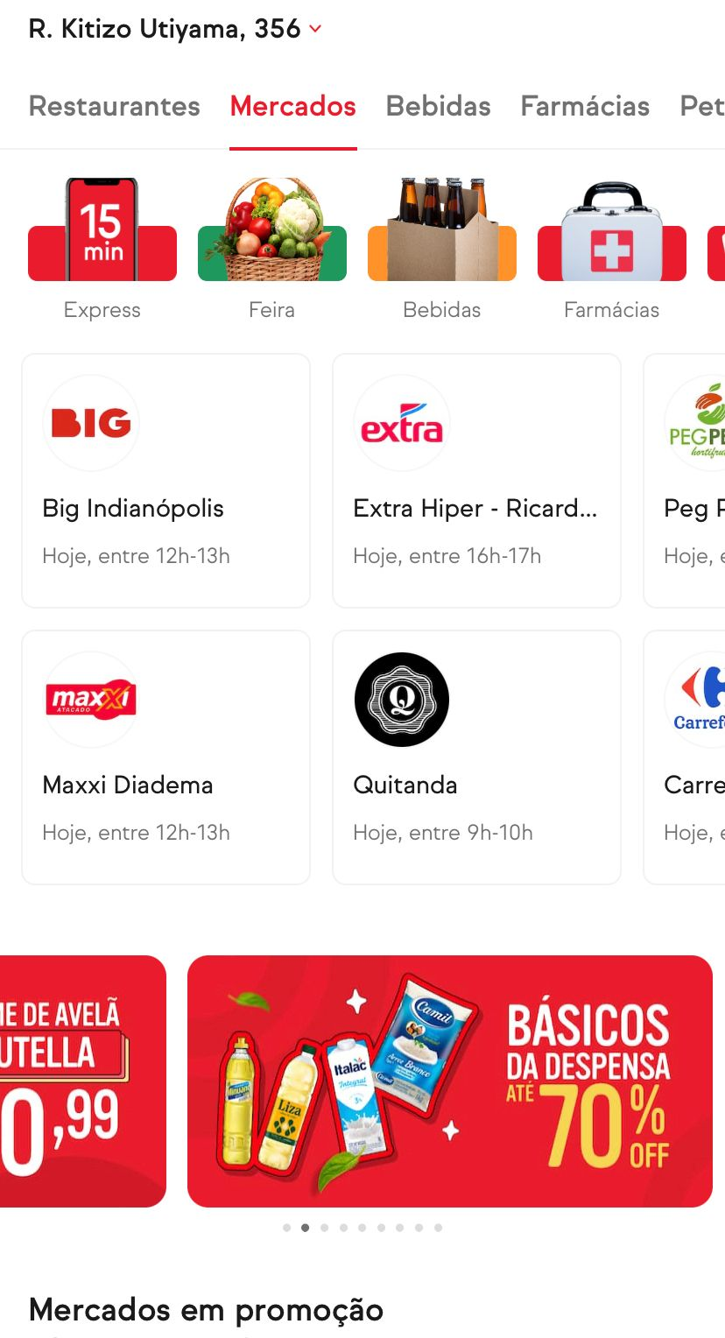
.Have a look in our catalog. What would you make it better? competitors
DAKI
RAPPI
IFOOD

Slide 6
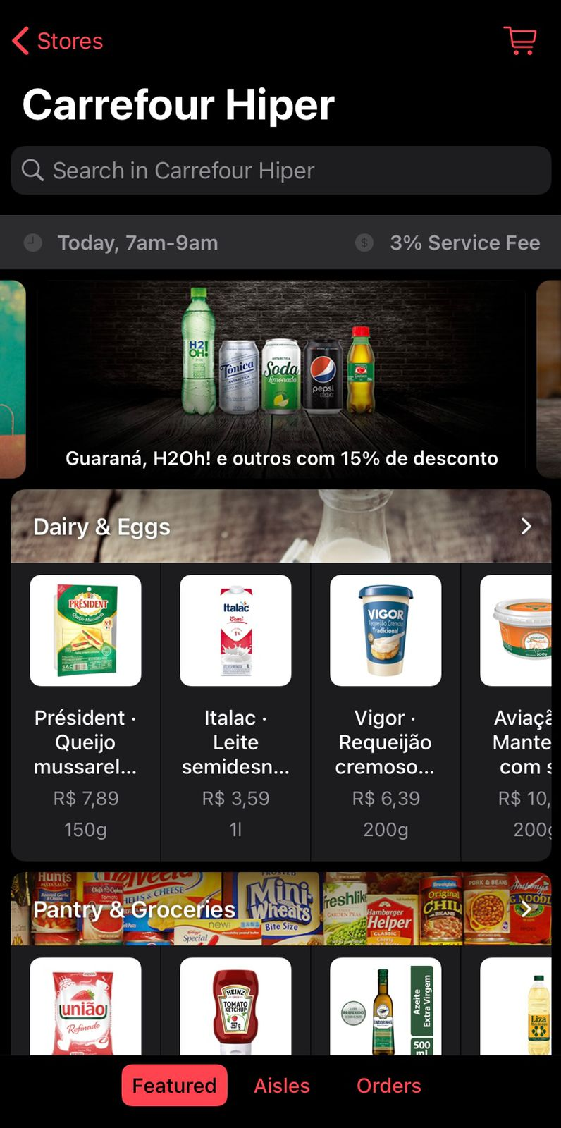
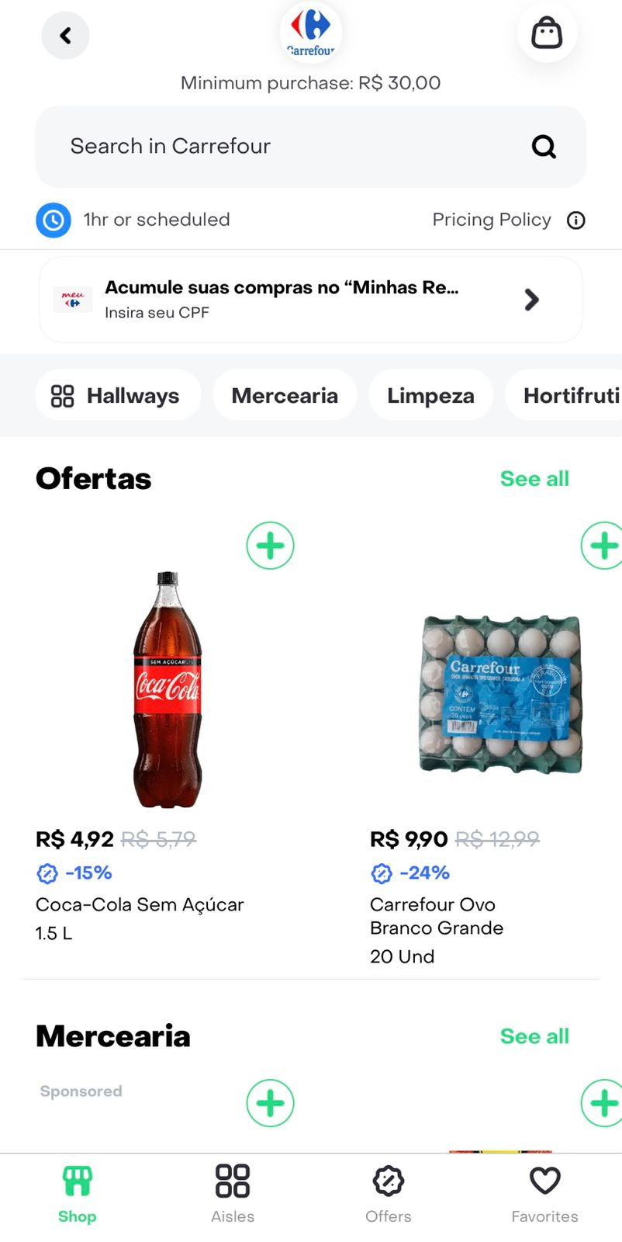
.Have a look in our catalog. What would you make it better? store page - featured
1. It doesn’t show infos that are important, such as minimum order value.
2. It doesn’t highlight properly the deals that the store are promoting
3. There is no way to add products into the cart by hitting a “+” button. So, it takes time for you to enter the product and then add it.
RAPPI
4. The miniatures are just too small and don’t add much. Also, some images contain some additional information that are not responsive, which causes discomfort.

Slide 7
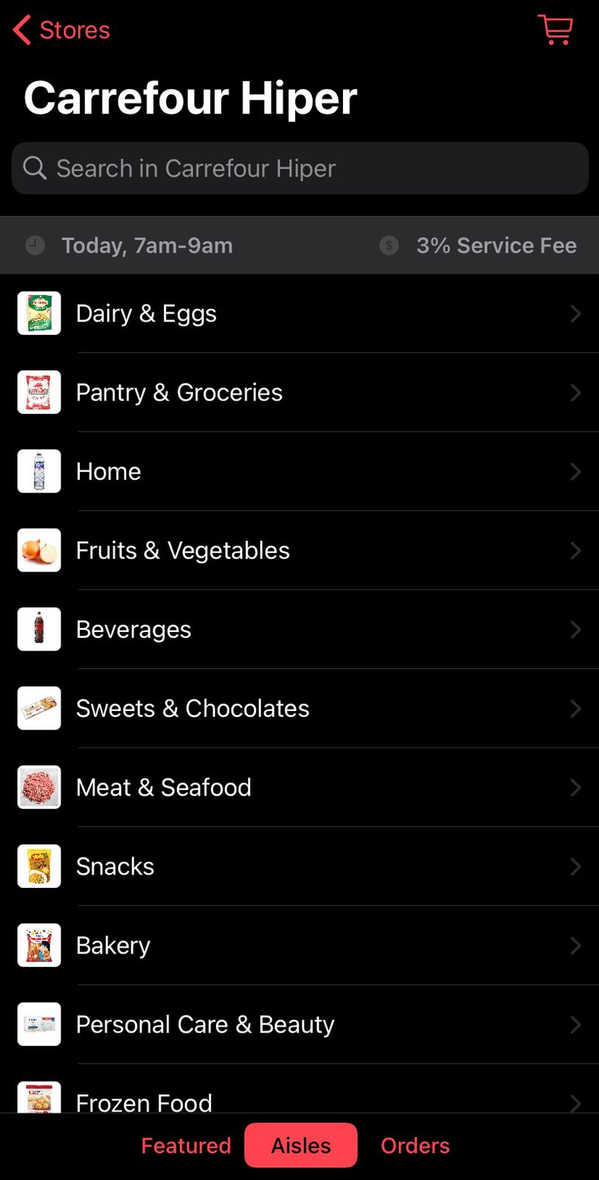
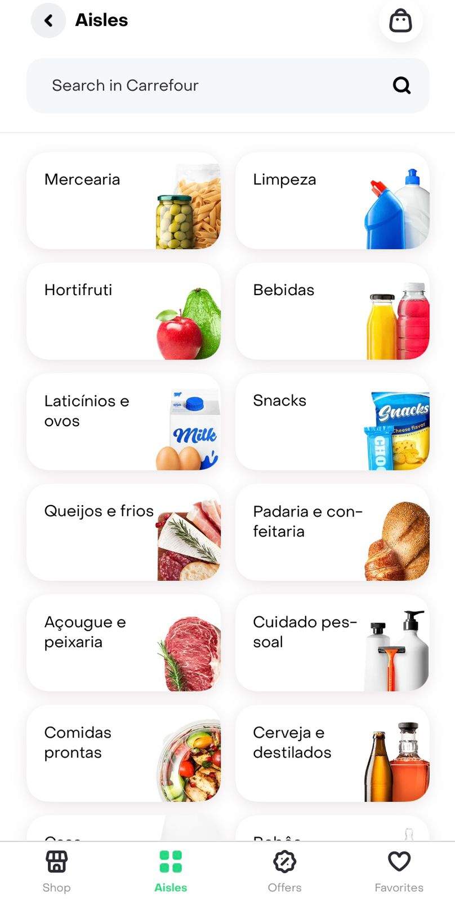
.Have a look in our catalog. What would you make it better? store page - aisle
1. The navigation buttons below should have icons instead of only text. It is important because the only language available is English and the word “aisle” is not very common.
2. The size of the icons that represents each aisle are just too small.
RAPPI

Slide 8
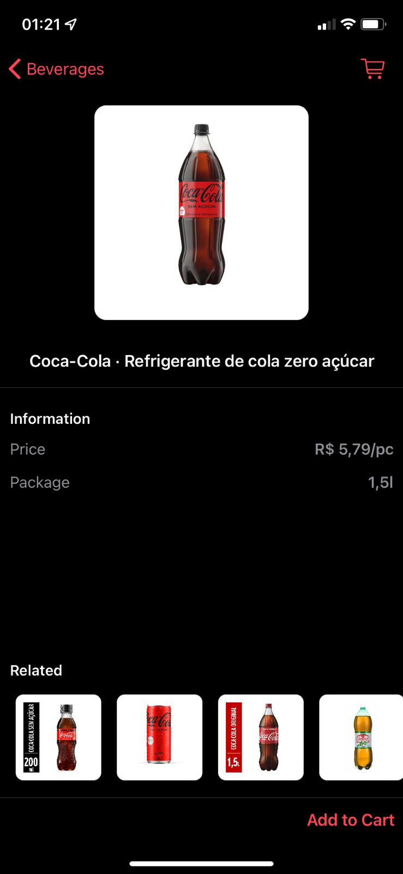
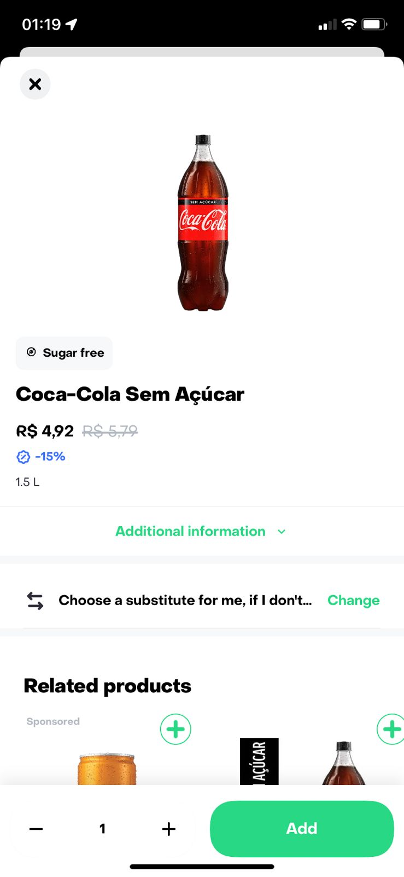
.Have a look in our catalog. What would you make it better? store page - product
1. “Add cart button” is in a weird position and it doesn’t have a icon such as “+”. Add cart button is in a weird position.
2. Description should be a expandable box in order to not take up too much space. Also, displaying the nutritional information would be a plus.
RAPPI

Slide 9
Q&A - 2
We are partners with a huge grocery chain in Brazil, and a few of its branches are presenting bad FR: Porto Alegre, Santos and Campinas.
We investigated the categories, product (if there is any specific offender), day and hour data and found no trend.What else would you analyze in order to improve these branches’ FR? Which tests would you do in order to have more insights on the issue?

Slide 10
.We are partners with a huge grocery chain in Brazil, and a few of its branches are presenting bad FR: Porto Alegre, Santos and Campinas.
We investigated the categories, product (if there is any specific offender), day and hour data and found no trend. What else would you analyze in order to improve these branches’ FR? Which tests would you do in order to have more insights on the issue?
I would like to understand if we are selling more products in those branches or not. We have to figure out if it is a matter of over selling or insufficient stock for normal demand. For that, I would go through all the steps below:
Discount: The people surrounding those areas could be much more responsive to offers/deals. So, I would track products and deals from this date in order to discover them (correlation between order increasing and discount),
Product price: Are the the cheaper products in the categories that have been causing the FR to drop? I would analyze the data to discover it.
Display position on the screen: Is the product display position pushing its sales? I would track it and have conclusions on it.
Availability: Are those branches making available fewer products than they should? I would analyze the order's history and see if the bad FR is something that is going on for a long time. Also, I would compare the performance of the branches with the local competitors and see if they normally make available more products (on average) than the branches that are under investigation.
API: Would it be a matter of having issues with the API or updating frequency from the store ERP to our system? I would check numbers from each system and see if they match perfectly.
FR = quantity of products found by the shopper / quantity of products order by the shopper

Slide 11
Q&A - 3
A big partner of us is having drops of almost 3 points in FR at every 1st week of the month. What is your hypothesis on that? What can we do in order to not have those drops that impact our customer experience?

Slide 12
.A big partner of us is having drops of almost 3 points in FR at every 1st week of the month. What is your hypothesis on that? What can we do in order to not have those drops that impact our customer experience?
Hypothesis:
The first week of the month is when people get paid (salary and benefits VA/VR), so they buy more and the supply level drops considerably if a demand forecast does not exist. If this is the case, probably this shop sells basic food supplies at a reasonable price, because the high demand for products occurs when people have to refill their storage. Also, it could be the case that promotions have been done at the same period, for the best selling products.
Actions:
We should identify what items are causing the FR to drop, and measure how much the demand increases and for how long, in order to increase the availability of those products. Also, in order to equalize the product's demand, our drop prices should be done after the first week of every month, according to the seasonality observed.
In addition, we should recommend a different seller for the same product. This doesn’t help the seller, but it avoids people from getting frustrated with the app.

Slide 13
Thank you

